Slide 1
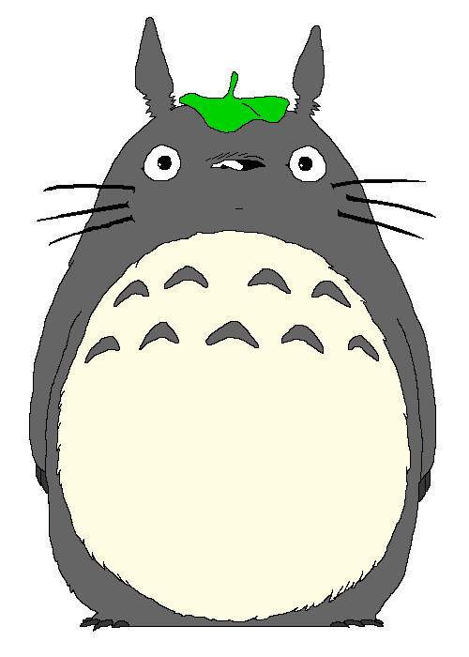
Minasan
KONNICHIWA!
Week 1 Term 2
HOME LEARNING
Years 5-7

Slide 2
WEEK 1 TERM 2 HOME LEARNING
Slide 1
Slide 2
Slide 3
Slide 4
Slide 5
Slide 6
Slide 7
Slide 8
Slide 9
Slide 10
Slide 11
Slide 12
Title page
Contents
Video to watch –Japanese writing systems
Hiragana recognition-click on Totoro
Instructions for hiragana practice
Ten, ten and maru title page
Ten- ten and maru explained
Ten- ten and maru task
Word of the week
Revision- title page
Revision task
End Slide

Slide 3
PLEASE WATCH THIS VIDEO
There are three Japanese writing systems, kanji , katakana and hiragana .

Slide 4
Click totoro to learn what sound each kana makes
HIRAGANA RECOGNITION

Slide 5
HIRAGANA PRACTICE
TASK
(15 minutes)
Choose 5 hiragana from your hiragana booklet (if you have it at home) or use the charts provided to practice writing 5 kana using the correct stroke order. A note-book or a piece of paper is great!

Slide 6
Ten-Ten ” and Maru

Slide 7
Ten-Ten ” and Maru
New sounds are formed when we add a ten- ten or a maru to a regular hiragana.
Example: ka to ga かーが
Old Sounds | ” | o
K | G
S | Z / J
T | D
H | B | P
Example: sa to za さーざ
Example: shi to ji しーじ
Example: ta to da たーだ
Example: ha to ba はーば
Example: ha to pa はーぱ

Slide 8
TASK INSTRUCTIONS
Use the ten-ten and maru practice sheets and practice writing the new hiragana.
Copy these words into a note-book or on a piece of paper and write them in romaji (using English letters).
Example- うさぎ（rabbit) usagi
にほんご (Japanese) えいが (movie)
おんがく (music) えいご (English)

Slide 9
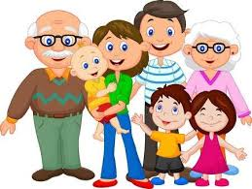
WORD OF THE WEEK
FAMILY
kazoku
かぞく
Notes:
Add background colour

Slide 10
REVISION

Slide 11
Watch this video to revise the Japanese numbers 1-20
TASK
1) Download the Number Chart and print out worksheets to work on.
2) Practise numbers 1-100 and make up 5 of your own maths sums like we have done in class.
Eg . 七 ＋ 八 = 十五(jū go)

Slide 12
Teach your mum and dad / caregivers something that you have learnt About in Japanese this week!

